Slide 1
CMS Migration to SiteManager
Division of Construction Management

Slide 2
Construction Management System
CMS was implemented in 1993
First large system that made use of PCs, client-server software, and local and wide area networks.
CMS pushed ODOT into the age of information technology.

Slide 3
Why Move to SiteManger?
CMS
SiteManager
High cost to maintain
CMS is a mainframe application and ODOT is moving in the direction of removing all applications from Supra 2X
Unable to make significant enhancements to the application
Slow speed
No archive capabilities. Every project imported into CMS since 1993 is still in CMS
Limited to no growth for the future
Same vendor developed CMS
Vendor maintenance releases and yearly upgrades
ODOT can submit and gets to vote on enhancements
SiteManager is part of the AASHTO product line which integrates with PES/LES, BAMS/DSS, Expedite, Estimator, SiteXchange
21 other states use SiteManager - Large user support community
Growth for Future – off-line capabilities, standard electronic doc. templates, key-event e-mail distribution, file attachment, and an archive module

Slide 4
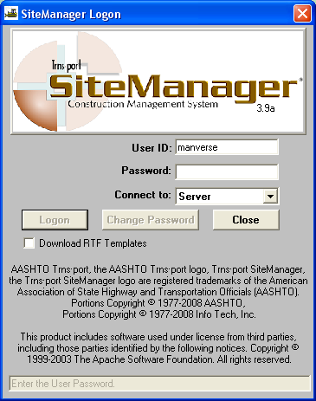
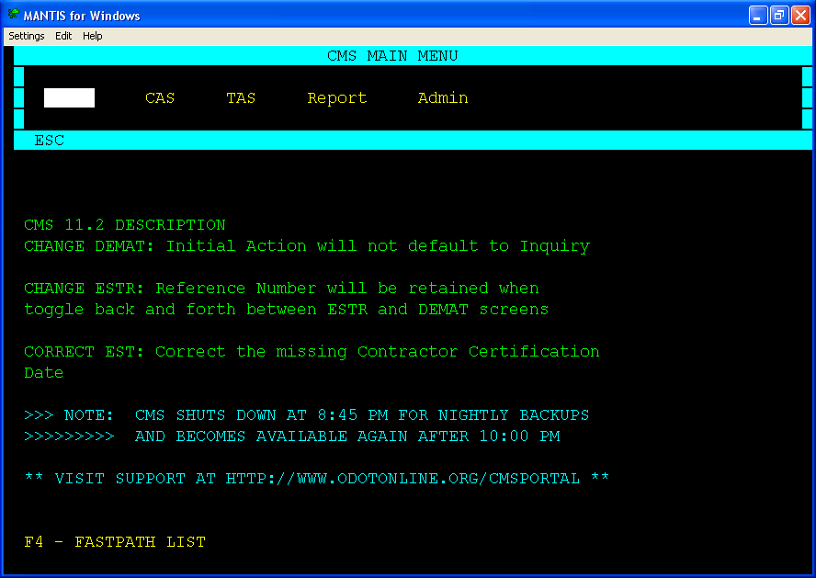
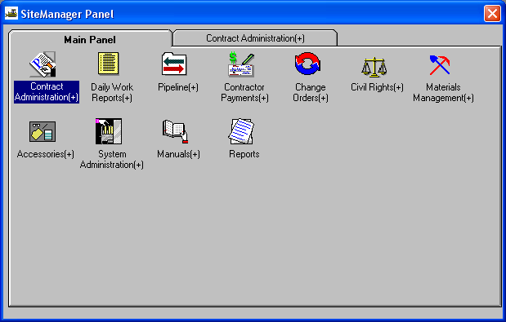
Old Vs New

Slide 5
Pilot
Implementation – March, 2010
24 identified multi-year projects
7 districts
First projects to start work in March, 2010
Begin user training in February, 2010
No conversion projects until 2011

Slide 6
A Few Things to know
SiteManager projects will run in parallel with CMS until ODOT is confident SiteManager is working correctly.
SiteManager will run in a terminal services environment located at the SOCC instead of being installed locally on the PC’s. No more updates to download.
CMS Portal reports are being rewritten to reflect SiteManager terminology and pull project data.
A SiteManager GQL data model has been built.
Virtual Warehouse and WebCMS are being rewritten to pull SiteManager project data.

Slide 7
Terminology Changes
SiteManager Contract ID Vs CMS Project Number
Contract ID = MOT77246 (county/PID)
Project Number = 09-0103
SiteManager Line Item Vs CMS Reference Number
Line Item = 0001
Reference Number = 1
SiteManager Alt. ID Vs CMS Project Number
Alt. ID = 09-0103
Project Number = 09-0103
SiteManager Project Number Vs CMS Part Code
Project Number = MOT77246-1/4 (Funding Identifier)
Part Code = 01

Slide 8
Challenges
CHANGE
Large project that involves many internal and external customers
CHANGE
Largest IT system implementation since the implementation of CMS
CHANGE
Training and Support
CHANGE
Marketing
CHANGE

